Slide 1
Enhanced Pix2pix Dehazing Network Yanyun Qu, Yizi Chen, Jingying Huang, Yuan Xie

Slide 2
Hello!
I am Raja Haseeb
I am a researcher at RIT lab in Electrical department.
You can find me at:
raja@rit.kaist.ac.kr

Slide 3
Contents
Problem definition
Introduction
Proposed Method
Results and Comparison
Ablation Study
Limitations
Conclusion
For more details, check the original paper at https://openaccess.thecvf.com/content_CVPR_2019/papers/Qu_Enhanced_Pix2pix_Dehazing_Network_CVPR_2019_paper

Slide 4
1.
PROBLEM DEFINITION

Slide 5
Problem Definition
Haze is a typical atmospheric phenomenon, and it causes color distortion, blurring and low contrast for the photographed image
This results in the difficulties of subsequent tasks, such as object recognition and image understanding.

Slide 6
2.
INTRODUCTION

Slide 7
Previous Methods
Most of the successful approaches depend on the physical scattering model*
I(z) = J(z)t(z) + A(z)(1 - t(z))
Where,
I(z): observed hazy image, z is the pixel location
J(z): clean image
t(z): transmission map
A(z): atmospheric light
Solution depends on estimation of t(z) and A(z)
*Earl J McCartney. Optics of the atmosphere: scattering by molecules and particles. New York, John Wiley and Sons, Inc., 1976. 421 p., 1976

Slide 8
Previous Methods
Early dehazing methods are mostly prior based*
Estimates the transmission map by investigating the dark channel prior
Good dehazing effect to a certain extent
Limitations
Prior maybe easily violated in practice
Undesirable results
*Kaiming He, Jian Sun, and Xiaoou Tang. Single image haze removal using dark channel prior. In IEEE Conference on Computer Vision and Pattern Recognition (CVPR), pages 1956–1963, 2009.

Slide 9
Previous Methods
Some methods utilized deep convolutional neural networks to estimate transmission map*
Some employ the deep convolutional neural network to jointly estimate the atmospheric light and the transmission map**
Limitations
Depend on physical scattering model
Estimation accuracies greatly influence the quality of the dehazed image
*Kui Jia Chunmei Qing Dacheng Tao Bolun Cai, Xiangmin Xu. Dehazenet: an end-to-end system for single image haze removal. IEEE Transactions on Image Processing, 25(11):5187–5198, 2016
**Xitong Yang, Zheng Xu, and Jiebo Luo. Towards perceptual image dehazing by physics-based disentanglement and adversarial training. In AAAI, 2018.

Slide 10
3.
PROPOSED METHOD

Slide 11
Method and Motivation
In order to disentangle image dehazing from the physical scattering model, we try to transform a hazy image to a haze-free image pixel by pixel directly.
Motivated by the success of generative adversarial networks (GANs) in image-to-image translation*, authors apply GAN to image dehazing.
Paper proposed Enhanced Pix2pix Dehazing Network (EPDN).
*Phillip Isola, Jun-Yan Zhu, Tinghui Zhou, and Alexei A Efros. Image-to-image translation with conditional adversarial networks. In Proceedings of the IEEE conference on computer vision and pattern recognition, pages 1125–1134, 2017

Slide 12
Contributions
EPDN is proposed for image dehazing
Embedded GAN and enhancer are designed to produce images with more details
Joint training scheme for updating embedded GAN and enhancer
Perceptual index (PI) is introduced for quantitative evaluation from the perceptual perspective
*

Slide 13
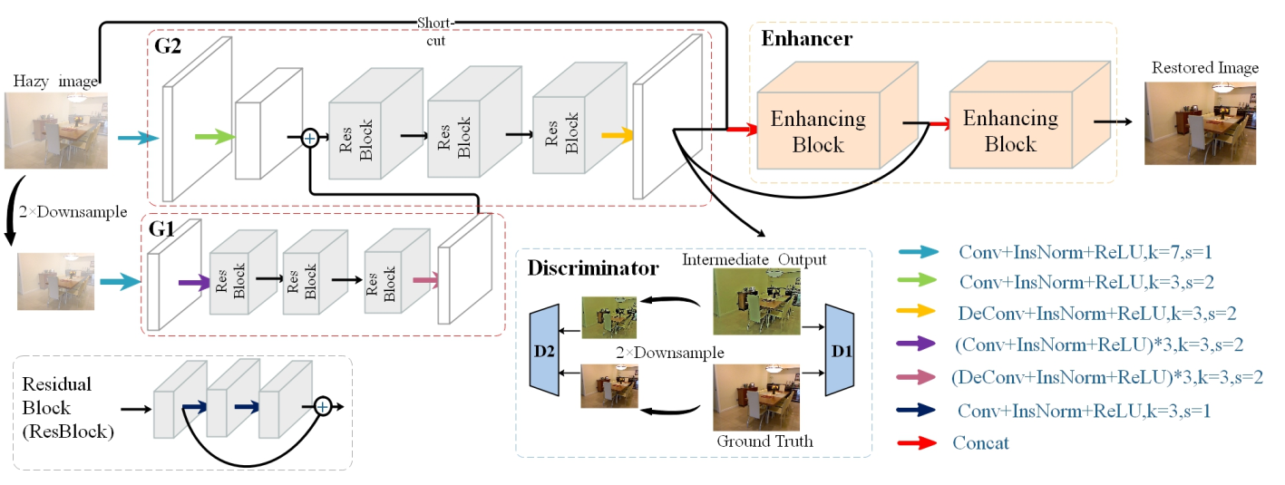
Architecture
Qu, Yanyun, et al. "Enhanced pix2pix dehazing network." Proceedings of the IEEE Conference on Computer Vision and Pattern Recognition. 2019.

Slide 14
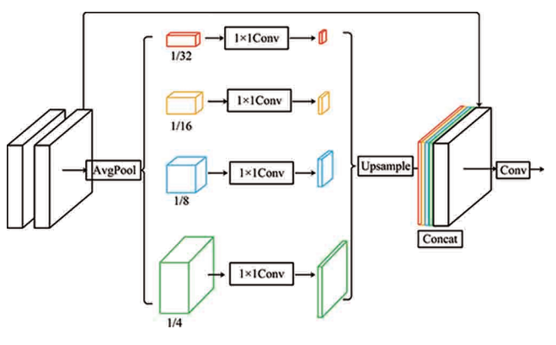
Architecture
Qu, Yanyun, et al. "Enhanced pix2pix dehazing network." Proceedings of the IEEE Conference on Computer Vision and Pattern Recognition. 2019.

Slide 15
Overall Loss
In order to optimize EPDN, the adversarial loss L_{A}, the feature matching loss L_{FM} , the perceptual loss L_{VGG}, and the fidelity loss L_{F}
L_{EP} = L_{A} + λL_{FM}+ λL_{VGG} + L_{F}

Slide 16
Training
A joint training scheme which alternatively optimizes the embedding GAN (generator and discriminators) and the generator along with the enhancer.
Firstly, the GAN architecture is optimized with the adversarial loss function and the feature matching loss function
Secondly, the enhancer and the multi-resolution generator is optimized by descending the gradient of the sum of perceptual loss and fidelity loss

Slide 17
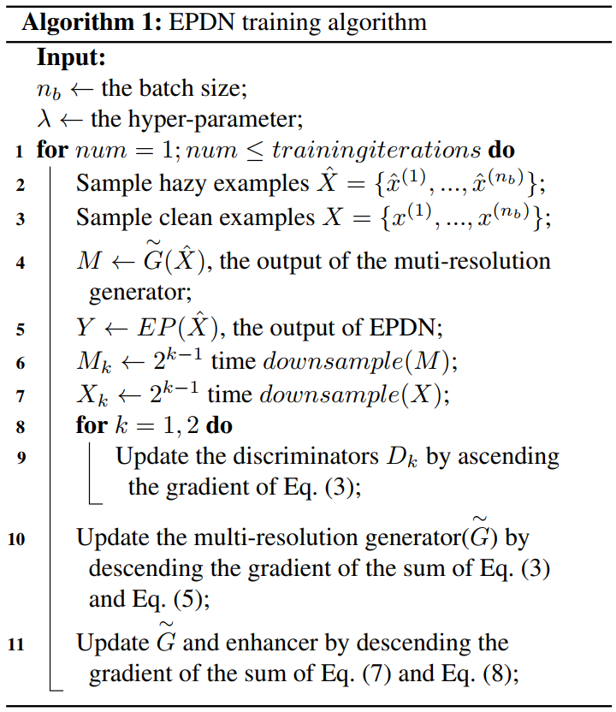
Training
Adversarial and feature matching loss
Perceptual and fidelity loss

Slide 18
4.
RESULTS AND COMPARISON

Slide 19
Experiments
Experiments are done on both the synthesis dataset and the real-world dataset to demonstrate the effectiveness of the proposed method.
ITS (Indoor Training Set) and SOTS (Synthetic Objective Testing Set) which contain both indoor and outdoor hazy images are respectively employed for training and testing
Three metrics: the Peak Signal to Noise Ratio (PSNR), the Structural Similarity index (SSIM) and Perceptual Index (PI), are used for performance evaluation
The lower the image quality is, the higher PI is.

Slide 20
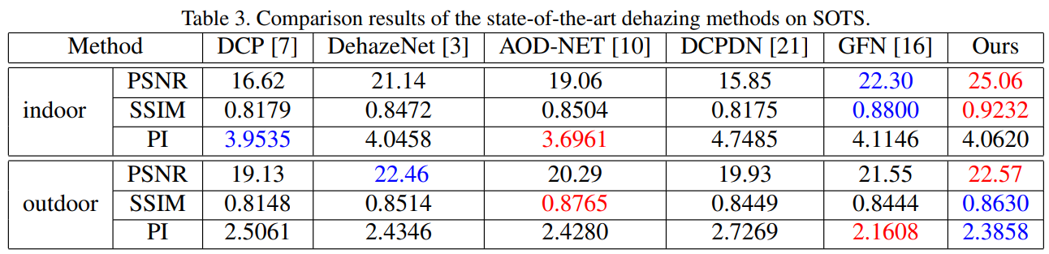
Comparison
Qu, Yanyun, et al. "Enhanced pix2pix dehazing network." Proceedings of the IEEE Conference on Computer Vision and Pattern Recognition. 2019.

Slide 21
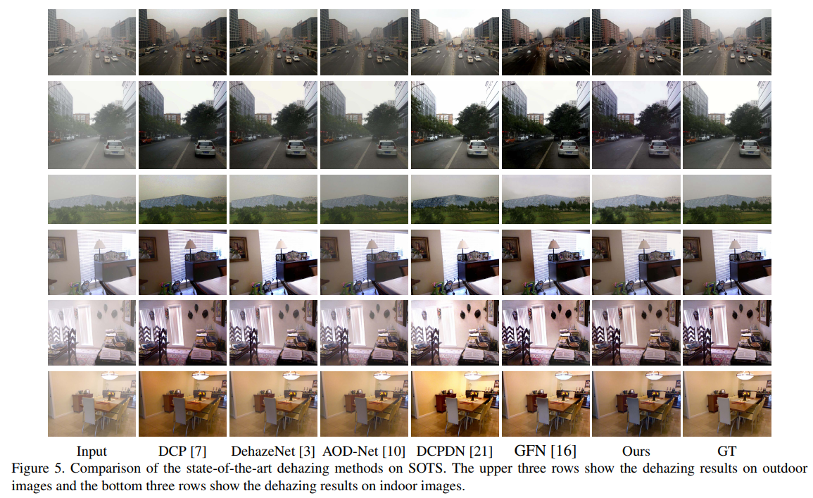
Comparison
Qu, Yanyun, et al. "Enhanced pix2pix dehazing network." Proceedings of the IEEE Conference on Computer Vision and Pattern Recognition. 2019.

Slide 22
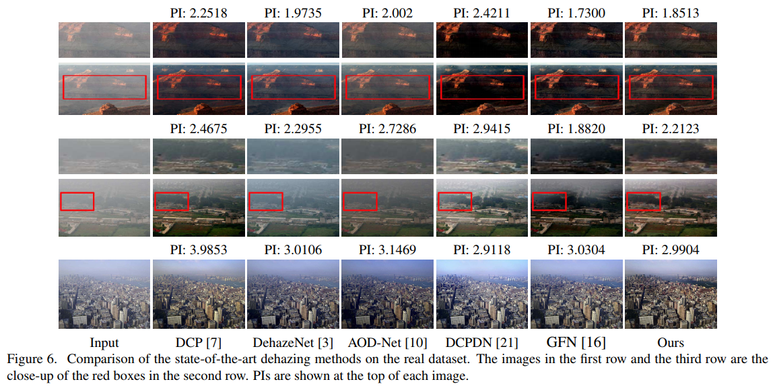
Comparison
Qu, Yanyun, et al. "Enhanced pix2pix dehazing network." Proceedings of the IEEE Conference on Computer Vision and Pattern Recognition. 2019.

Slide 23
5.
ABLATION STUDY

Slide 24
Ablation Study
These ablation study demonstrates that the enhancing blocks, the short-cut skip, and the embedded structure are effective for image dehazing.

Slide 25
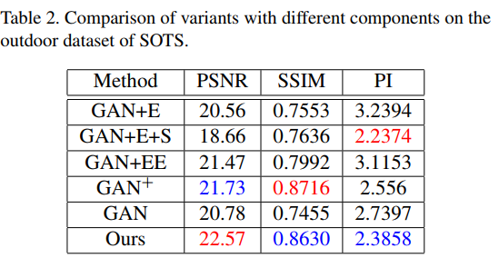
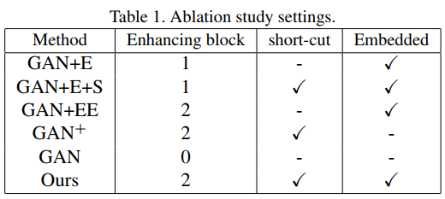
Ablation Study
Qu, Yanyun, et al. "Enhanced pix2pix dehazing network." Proceedings of the IEEE Conference on Computer Vision and Pattern Recognition. 2019.

Slide 26
6.
LIMITATIONS

Slide 27
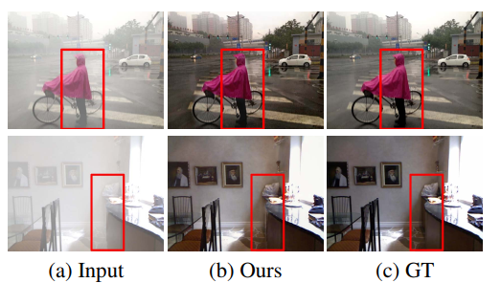
Limitations
Not robust for scenes with heavy haze
Edges not recovered in a natural way
Might be solved by adding more enhancing blocks
Qu, Yanyun, et al. "Enhanced pix2pix dehazing network." Proceedings of the IEEE Conference on Computer Vision and Pattern Recognition. 2019.

Slide 28
7.
CONCLUSION

Slide 29
Conclusion
Proposed Enhanced Pix2pix Dehazing Network (EPDN) which does not rely on the estimations of the transmission map and atmospheric light.
Experimental results on both the synthesis dataset and the real-world dataset demonstrate that the proposed method achieves the best performance of image dehazing in both the quantitative and qualitative evaluations. Especially, it keeps the faithful color and structures.
No comments or remarks on openreview

Slide 30
Thanks you!
Any questions?
You can find me at:
raja@rit.kaist.ac.kr

